Slide 1
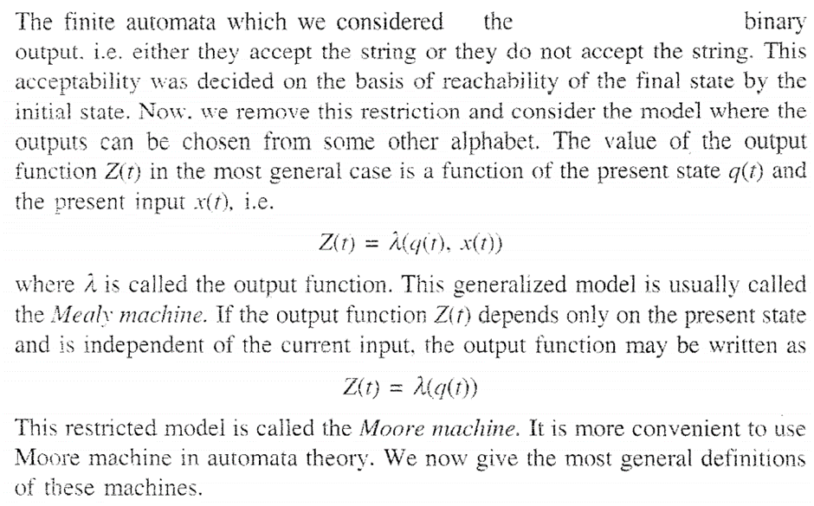
Mealy Machine and Moore Machine

Slide 2
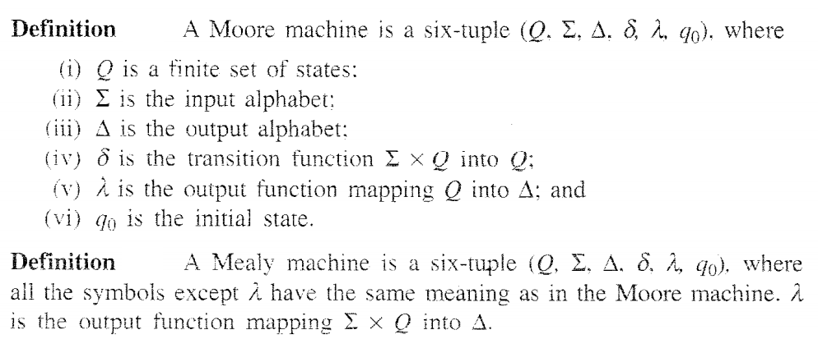
Mealy Machine and Moore Machine

Slide 3
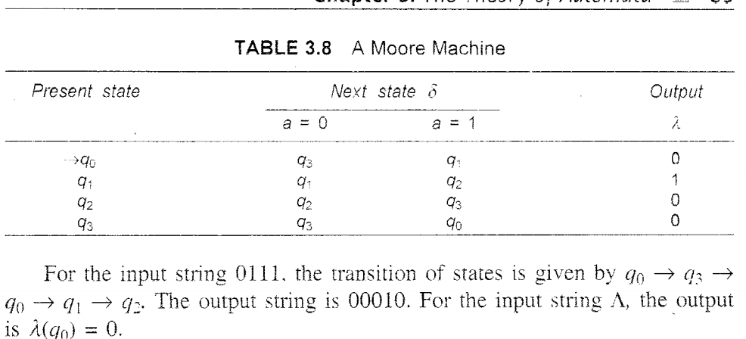
Mealy Machine and Moore Machine

Slide 4
Mealy Machine and Moore Machine

Slide 5
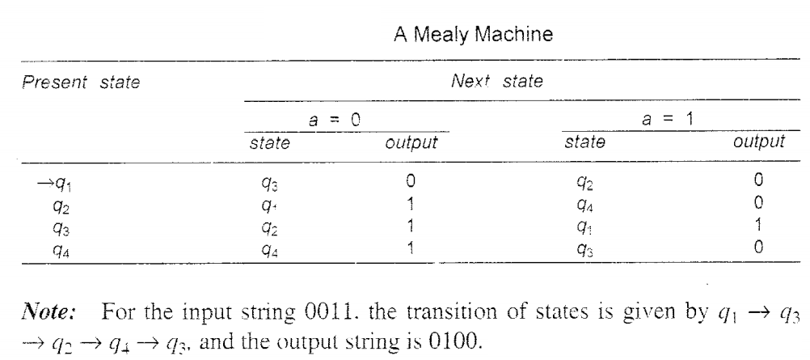
Mealy Machine and Moore Machine

Slide 6
Mealy Machine and Moore Machine

Slide 7
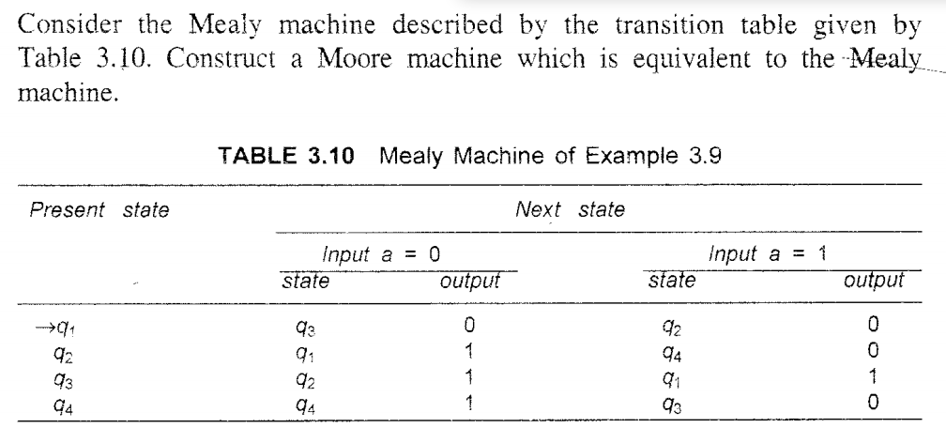
Mealy Machine and Moore Machine

Slide 8
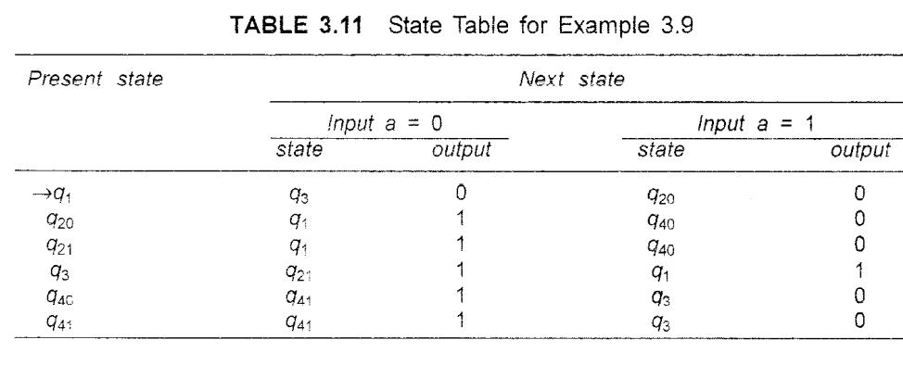
Mealy Machine and Moore Machine

Slide 9
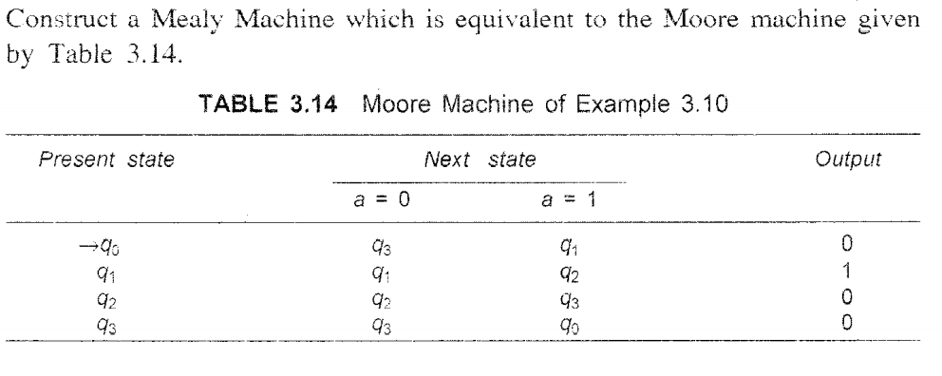
Mealy Machine and Moore Machine

Slide 10
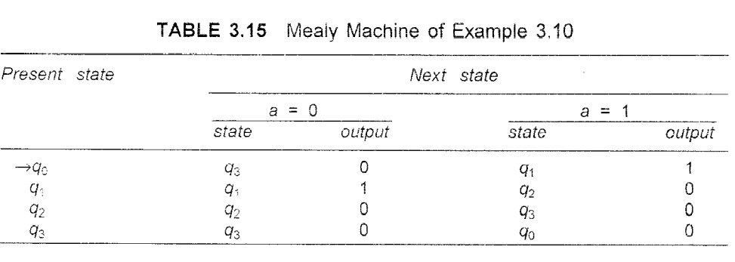
Mealy Machine and Moore Machine

Slide 11
Mealy Machine and Moore Machine

Slide 12
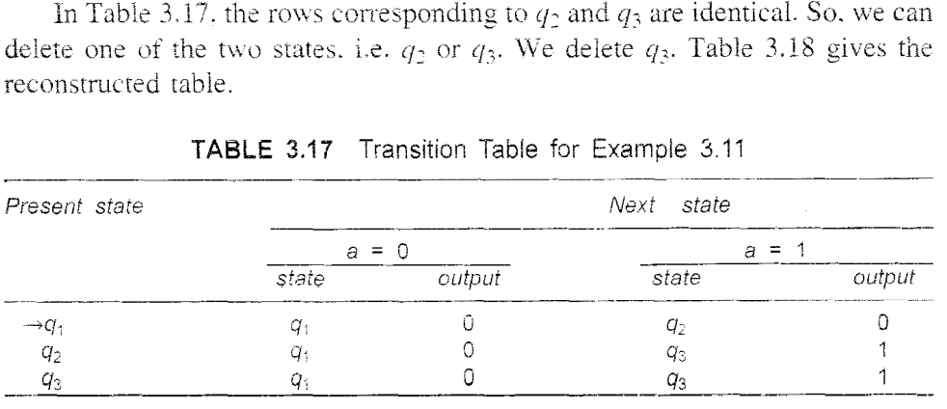
Mealy Machine and Moore Machine

Slide 13
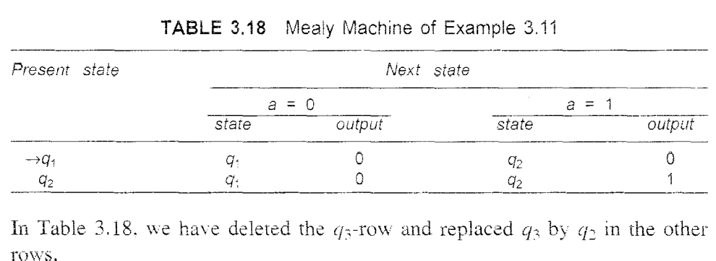
Mealy Machine and Moore Machine

Slide 14
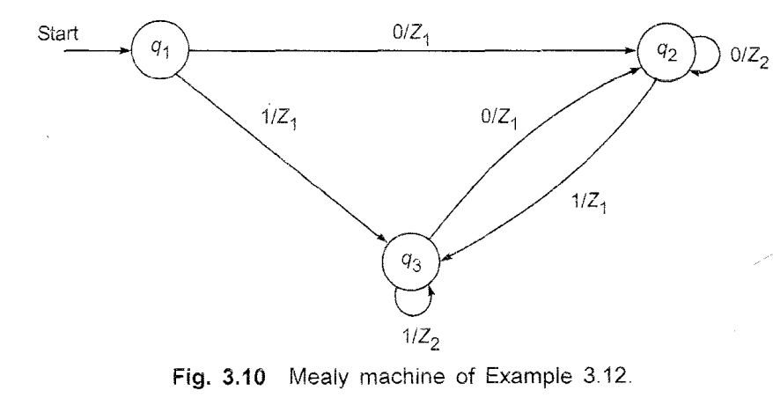
Mealy Machine and Moore Machine

Slide 15
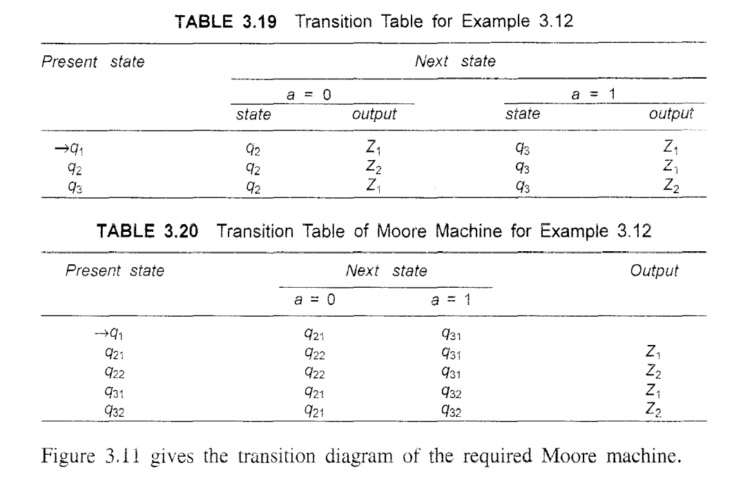
Mealy Machine and Moore Machine

Slide 16
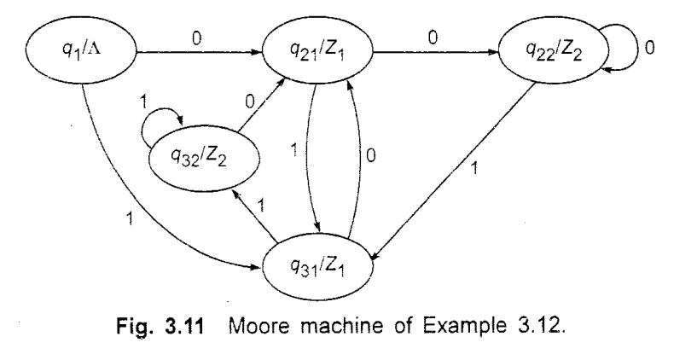
Mealy Machine and Moore Machine

Slide 17
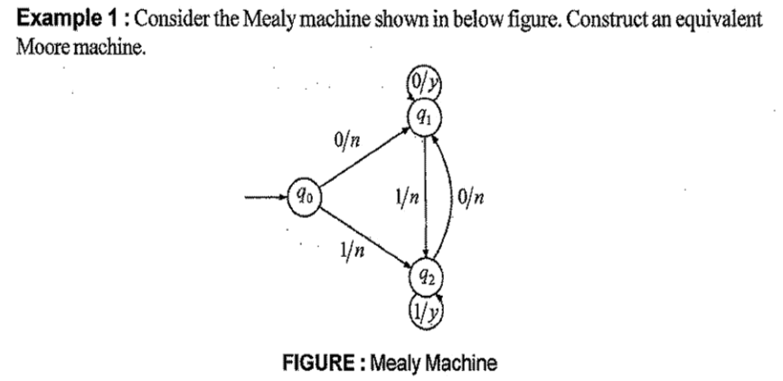
Mealy Machine and Moore Machine

Slide 18
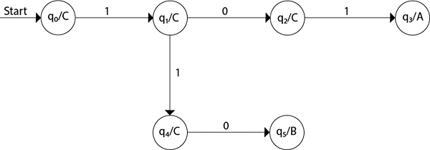
Mealy Machine and Moore Machine
Design a Moore machine for a binary input sequence such that if it has a substring 101, the machine outputs A, if the input has substring 110, it outputs B otherwise it outputs C.

Slide 19
Mealy Machine and Moore Machine
Design a mealy machine that scans sequence of input of 0 and 1 and generates output ’A’ if the input string terminates in 00, output ’B’ if the string terminates in 11, and output ’C’ otherwise.

Slide 20
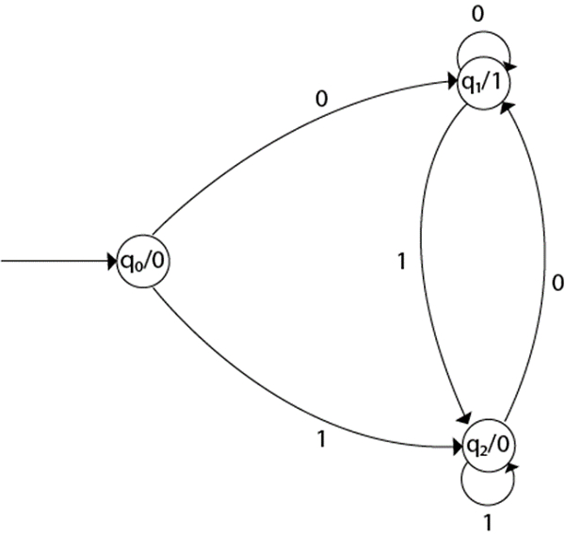
Mealy Machine and Moore Machine
Design a Moore machine to generate 1's complement of a binary number.

Slide 21
Mealy Machine and Moore Machine
Step 1 − q0 is the start state on input ‘0’ goes to q1 state and on ‘1’ goes to state q2 generating output 0.
Step 2 − q1 on input ‘0’ goes to q1 itself and on ‘1’ goes to q2 generating output ‘1’.
Step 3 − q2 on input ‘0’ goes to q1 and on ‘1’ goes to q2 generating output ‘0’.

